Slide 1
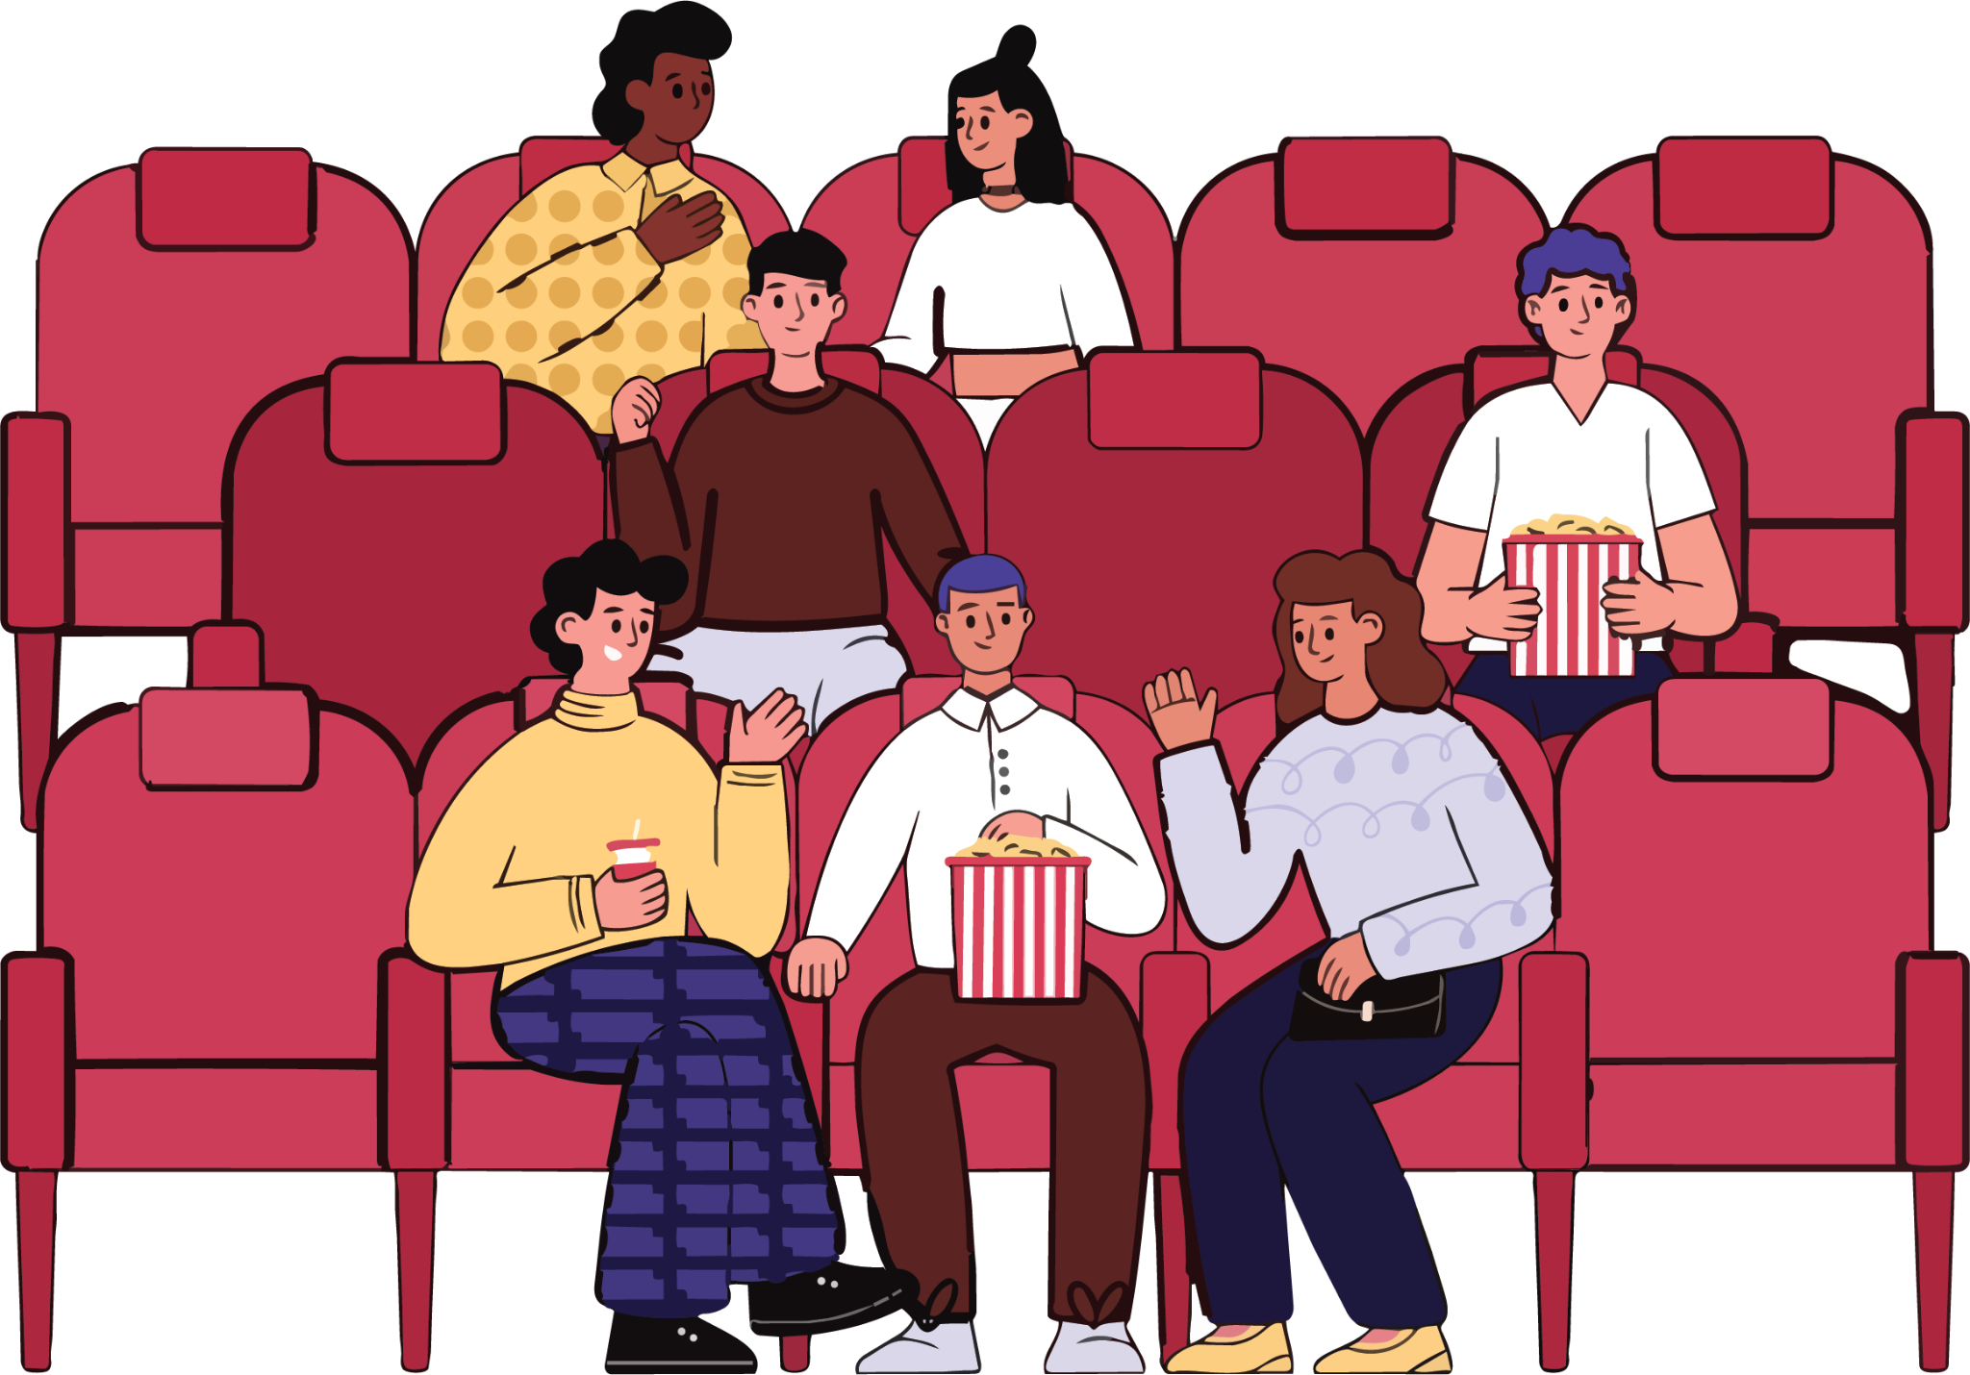
Party Finder
Features
Connect with other people going to the same show as you.
List yourself for others to join
Send an invite to a show
Plan ahead of time with a group of friends

